Slide 1
Chapter 9 Relations
9.1 Relations and Their Properties
9.2 n-ary Relations and Their Application
9.3 Representing Relations
9.4 Closures of Relations
9.5 Equivalence Relations
9.6 Partial Orderings

Slide 2
9.6 Partial Orderings
1. Partial Orderings
【Definition】Let R be a relation on a set S. Then R is a partial ordering or partial order if R is
        reflexive
        antisymmetric
        transitive
Notation: (S, R) ---- partially ordered set or a poset
〖Example 1〗

Slide 3

9.6 Partial Orderings
Notation:
a ≼ b
【Definition】comparable/ incomparable
The elements a and b of a poset (S,≼ ) are comparable if either a ≼ b or b ≼ a. When a and b are elements of S so that neither a ≼ b nor b ≼ a, then a and b are called incomparable.
For example,

Slide 4




9.6 Partial Orderings
【Definition】If (S,≼ ) is a poset and every two elements of S are comparable, S is called a totally ordered or linearly ordered set, ≼ is called a total order or linear order. In this case (S,≼ ) is also called a chain.
〖Example 2〗
(1) is a poset. In this case either . Hence, ≤ is a total order and is a chain.
(2) is a poset, not a totally ordered set.
(3) is a poset, not a totally ordered set.

Slide 5
9.6 Partial Orderings
2. Lexicographic Order
Definition: Given two posets (A₁,≼₁) and (A₂,≼₂), the lexicographic ordering on A₁ ⨉ A₂ is defined by specifying that (a₁, a₂) is less than (b₁,b₂), that is,
(a₁, a₂) ≺ (b₁,b₂),
either if a₁ ≺₁ b₁ or if a₁ = b₁ and a₂ ≺₂ b₂.

Slide 6


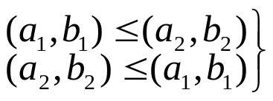

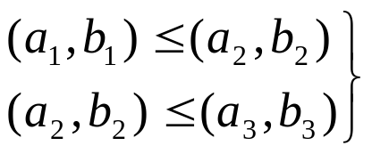

9.6 Partial Orderings
A lexicographic ordering on the Cartesian product of two posets is a partial ordering.
Proof:
reflexive
 antisymmetric
 transitive

Slide 7




9.6 Partial Orderings
〖Example 3〗Let . Then
(2, 4) < (2, 8) since
(2, 4) is not related under R to (2, 6) since
but 4 does not divide 6.
(2, 4) < (4, 5) since

Slide 8


9.6 Partial Orderings
This definition of lexicographic ordering extends naturally to Cartesian products of more than two partially ordered sets.
〖Example 4〗 Using the same definitions of as above,
( 2, 3, 4, 5) < ( 2, 3, 8, 2) since and 4 divides 8.
(2, 3, 4, 5) is not related to (3, 6, 8, 10) since 2 does not divide 3.

Slide 9


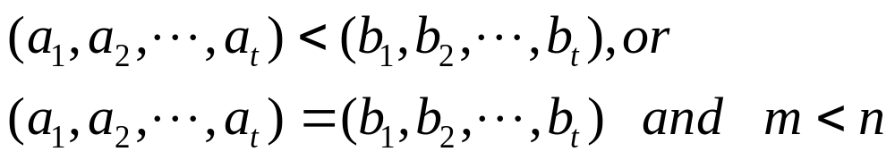

9.6 Partial Orderings
lexicographic ordering of string
The string is less then if and only if
Where
For example,
Find the lexicographic ordering of the following strings.
discrete discredit discreet discreteness discretion
discredit < discreet < discrete < discreteness < discretion

Slide 10
9.6 Partial Orderings
3. Hasse Diagrams
Hasse Diagrams
---- A method used to represent a partial ordering
To construct a Hasse diagram:
1) Construct a digraph representation of the poset (A, R) so that all arcs are pointed upward (except the loops).
2) Eliminate all loops
3) Eliminate all arcs that are redundant because of transitivity
4) Eliminate the arrows at the ends of arcs since everything points up.

Slide 11
9.6 Partial Orderings
〖Example 5〗
8
4
6
9
2
3
5
7
1

Slide 12
9.6 Partial Orderings
〖Example 5〗
8
4
6
9
2
3
5
7
1

Slide 13
9.6 Partial Orderings
〖Example 5〗
8
4
6
9
2
3
5
7
1

Slide 14
9.6 Partial Orderings
〖Example 5〗
8
4
6
9
2
3
5
7
1

Slide 15
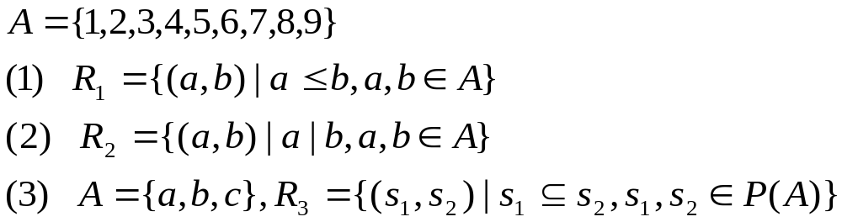
9.6 Partial Orderings
〖Example 6〗
9
8
7
6
5
4
3
2
1

Slide 16
9.6 Partial Orderings
〖Example 6〗
9
8
8
7
6
4
6
9
5
4
2
3
5
7
3
2
1
1

Slide 17
9.6 Partial Orderings
〖Example 6〗
9
8
{a,b,c}
8
7
6
4
6
9
{a,b}
{a,c}
{b,c}
5
4
2
3
5
7
3
{a}
{b}
{c}
2
1
1
φ

Slide 18



9.6 Partial Orderings
4. chain and antichain
【Definition】 is a poset. ，if is a
totally ordered set，then B is called a chain of .
，if
then B is called a antichain of .

Slide 19



9.6 Partial Orderings
5. Maximal and Minimal Elements
【Definition】Let be a poset. , then a is a
maximal element if there does not exist an element b in A such
that .
Similar defintion for a minimal element.

Slide 20
9.6 Partial Orderings
9
8
{a,b,c}
8
7
Note:
Maximal and minimal elements are the “top” and “bottom” elements in the Hasse diagram.
There can be more than one minimal and maximal element in a poset.
6
4
6
9
{a,b}
{a,c}
{b,c}
5
4
2
3
5
7
3
{a}
{b}
{c}
2
1
1
φ
(1)
(2)
(3)
      maximal element minimal element
(1) 9 1
(2) 8,6,9,5,7 1
      (3) {a, b, c} φ

Slide 21



9.6 Partial Orderings
6. Greatest and Least Element
【Definition】Let be a poset. Then an element a in A is a greatest element of A if for every b in A, and a is a least element of A if for every b in A.

Slide 22
9.6 Partial Orderings
9
8
{a,b,c}
8
7
6
4
6
9
{a,b}
{a,c}
{b,c}
5
4
2
3
5
7
3
{a}
{b}
{c}
2
1
1
φ
(1)
(2)
(3)
      The greatest element The least element
(1) 9 1
(2) / 1
      (3) {a, b, c} φ

Slide 23




9.6 Partial Orderings
【 Theorem 】 The greatest and least element of the poset
are unique when they exist.
Proof:
Suppose that a₁ is a greatest element in A. It follows that
for every x in A.
Suppose that a₂ is a greatest element in A. It follows that
for every x in A.
It implies that
That is

Slide 24

9.6 Partial Orderings
7. Upper and Lower Bounds
【Definition】Let A be a subset of S in the poset . If
there exists an element a in S such that for all b in A,
then a is called an upper bound of A.
Similar definition for lower bounds.

Slide 25
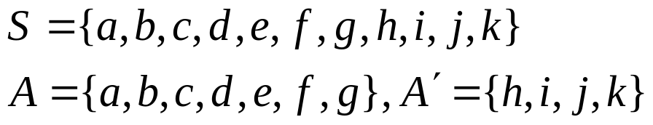
9.6 Partial Orderings
〖Example 7〗
j
k
the upper bounds of set A：h, i, k, j
the lower bounds of set A：/
the upper bounds of set A'：/
the lower bounds of set A'：f, g, a, b, c, d, e
h
i
g
f
e
b
c
d
a

Slide 26
9.6 Partial Orderings
8. Least Upper and Greatest Lower Bounds
【Definition】If a is an upper bound of the subset A which is less than every other upper bound of A, then a is the least upper bound, denoted by lub(A).
Similarly for the greatest lower bound, glb(A).

Slide 27

9.6 Partial Orderings
〖Example 8〗
Determine the maximal elements, minimal elements, greatest
element, least element of set A, the upper bounds, lower bounds ,
least upper bound , greatest lower bound of set 。
A:
maximal elements: 24,36 minimal elements:2,3
the greatest element: / the least element: /
24
36
12
B₁:
upper bounds: 6,12,24,36 lower bounds: /
The least upper bound: 6 The greatest lower bound:/
6
2
3
B₂:
upper bounds: / lower bounds: 12,6,2,3
The least upper bound: / The greatest lower bound:12

Slide 28


9.6 Partial Orderings
9. Well-ordered Sets
【Definition】A poset (A, R) is well-ordered set if every nonempty subset of A has a least element.
For example,
Note:
A well-ordered set is a totally ordered set.

Slide 29
9.6 Partial Orderings
10. Lattices
【Definition】A poset is called a lattice if every pair of
elements has a lub and a glb.
〖Example 9〗 Determine whether the following poset is
lattice.
(1)
5
2
4
1
3

Slide 30








9.6 Partial Orderings
(2) ?
lub：the larger of the two elements，
glb：the smaller of the two elements.
Hence, the poset is a lattice.
Note: Every totally ordered set is a lattice.
(3) ?
lub：the least common multiple，
glb：the greatest common divisor
Hence, the poset is a lattice.
(4) ?
, lub： glb：
Hence, the poset is a lattice.

Slide 31

9.6 Partial Orderings
11. Topological Sorting
The problem of project schedule:
  Suppose that a project is made up of n different tasks. Some tasks can be completed only after others have been finished. How can an order be found for these tasks?
We impose a total ordering ≤ on a poset (A,R) compatible with
the partial order if whenever .
Constructing a compatible total ordering from a partial
ordering is called topological sorting.

Slide 32
9.6 Partial Orderings
【 Lemma 1】 Every finite nonempty poset (S, ≤ ) has a minimal element.
Proof:
Choose an element a₀ of S.
If a₀ is not minimal, then there is an element a₁ with a₁ < a₀.
If a₁ is not minimal, there is an element a₂ with a₂ < a₁.
Continue this process, so that
If a_{n} is not minimal, there is an element a_{n+1} with a_{n+1} < a_{n}.
Since there are only finite number of elements in the poset,
this process must end with a minimal element.

Slide 33
9.6 Partial Orderings
Algorithm: To sort a poset (S, R).
Select a (any) minimal element and put it in the list. Delete it from S.
Continue until all elements appear in the list (and S is void).

Slide 34
9.6 Partial Orderings
〖Example 7〗A project is broken down into seven tasks. A
partial ordering on tasks is set up by considering task x < task y if
task y can’t be started until task x has been completed.
Find an order in which these tasks can be carried out to complete
the project.
G
G
G
D
D
F
D
F
F
B
B
B
E
E
A
E
C
C
G
D
F
G
D
F
E
The order for the task:
A<C<B<E<F<D<G
G
G
D

Slide 35
Homework: (Due on May 25)
Ver. 8 & Ver. 7
Sec. 9.6 5, 10, 23(a),(c), 32, 44, 66

